Slide 1
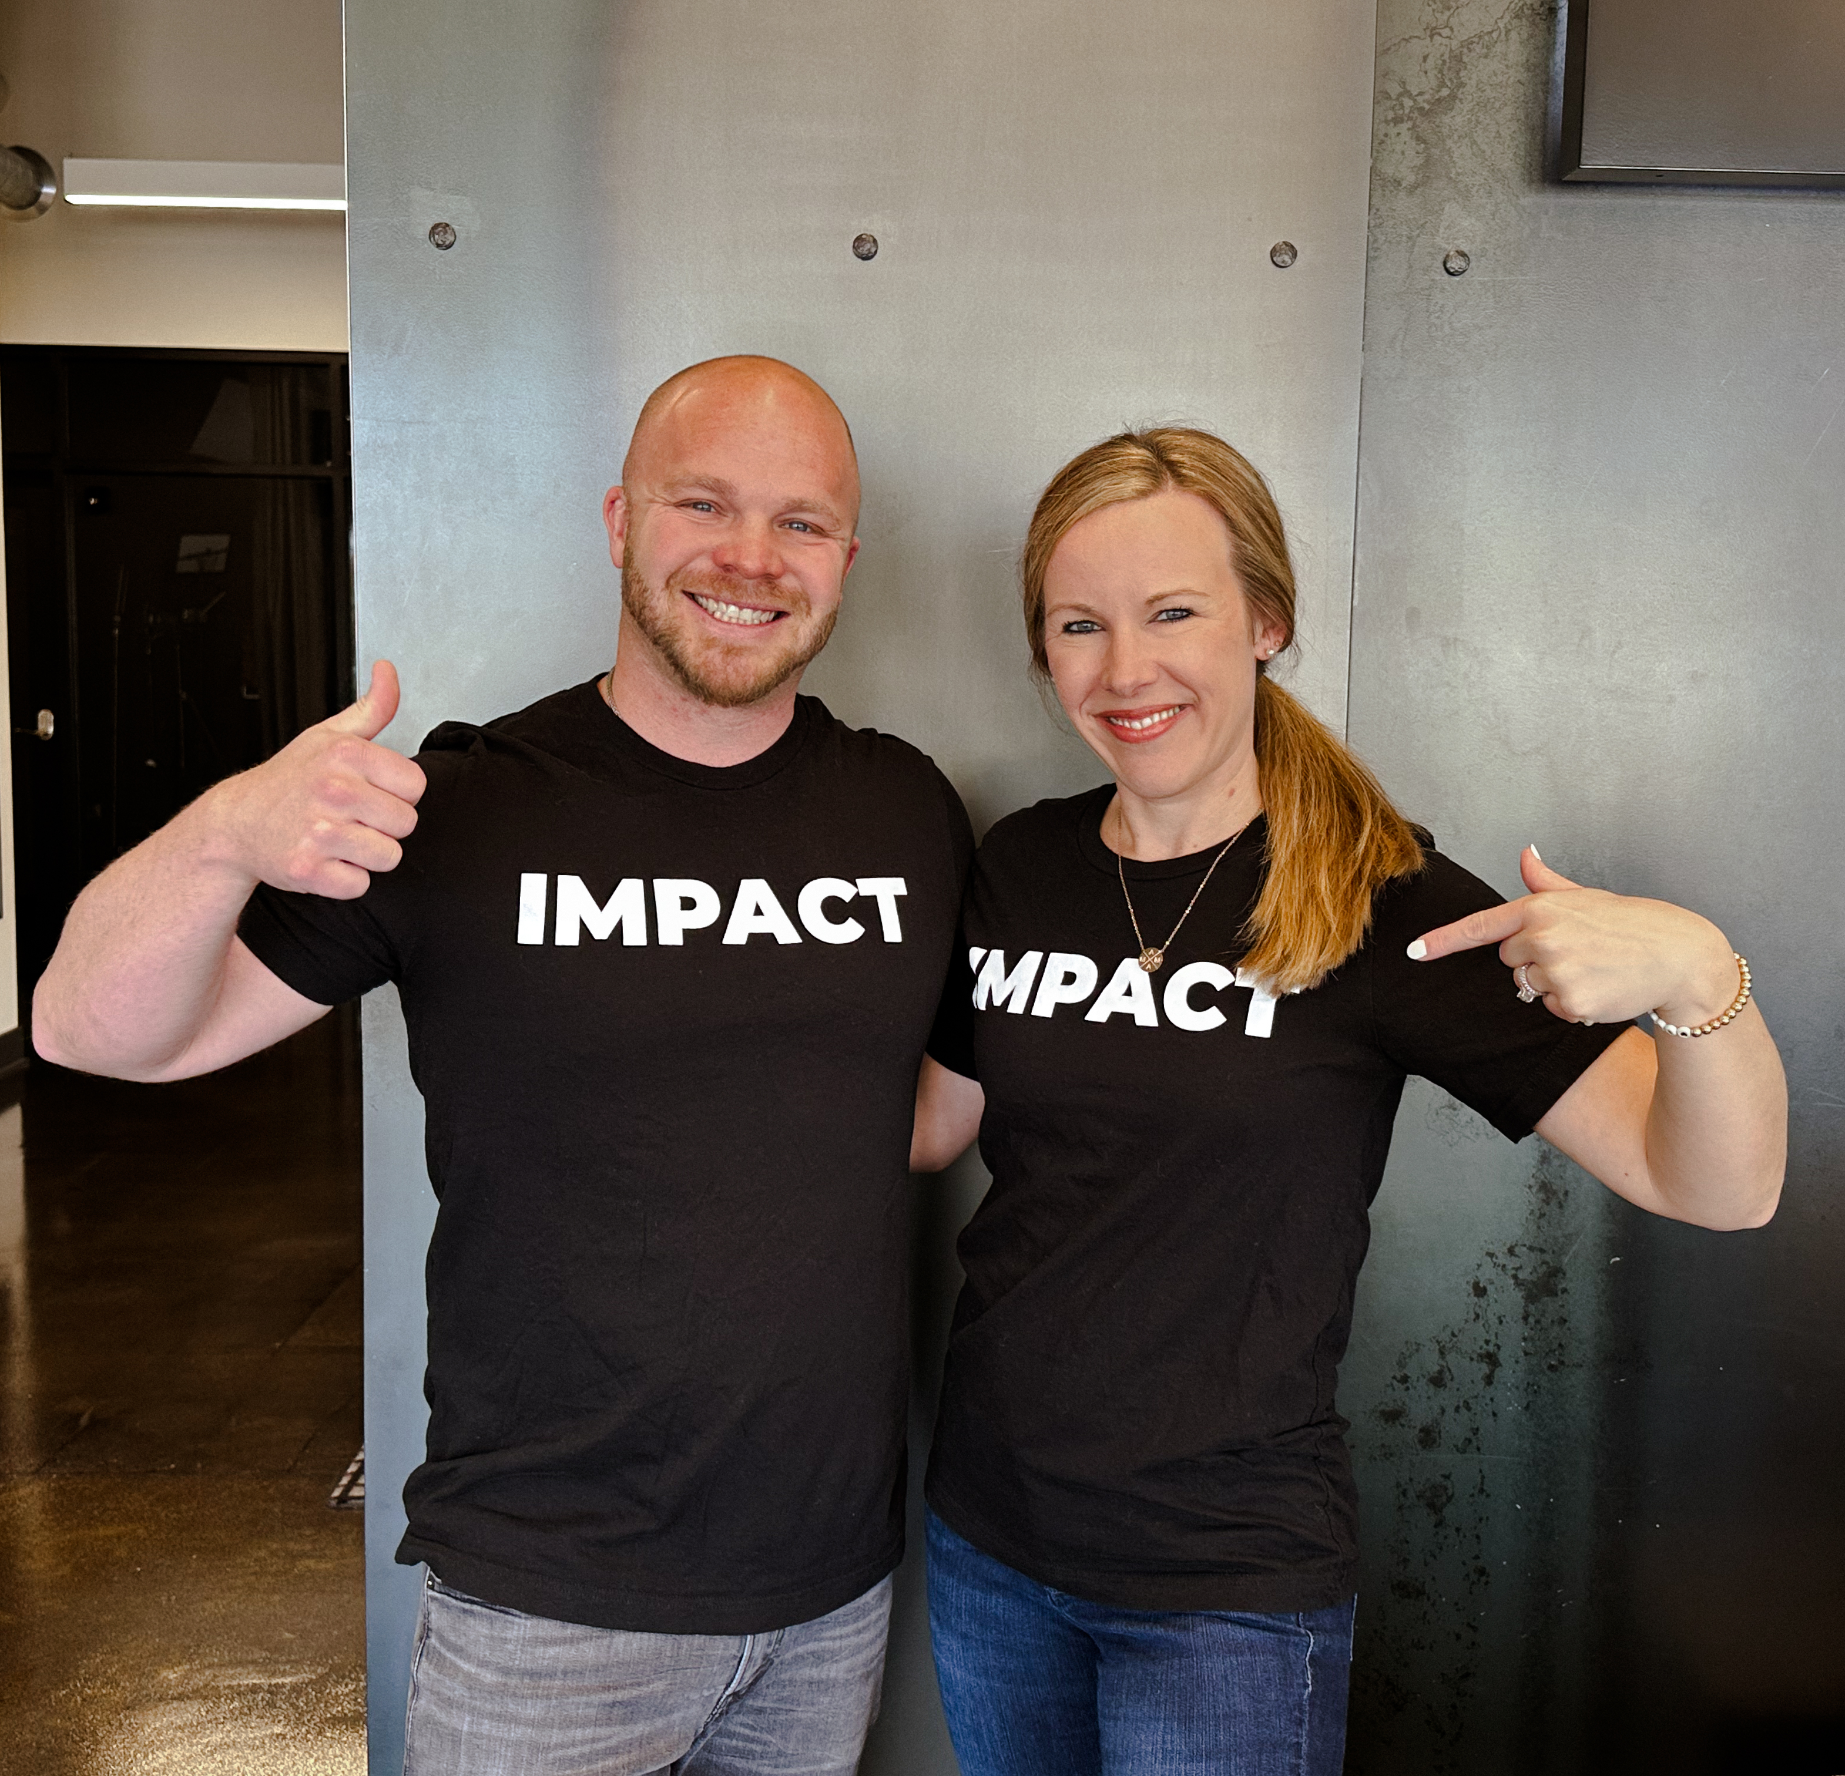


What do you WANT your family’s future to look like?
Phillip Clark, ChSNC
Founder & President

Slide 2
My Goals Tonight
  Briefly share my backstory:
    Who am I?
    Why do I care about your family’s special needs plan?
  Show you how the traditional approach to special needs planning failed my family and is likely failing yours, too
  Explain the exact steps to take to create a special needs plan that enables your child to live a great life today – and in the future
  Empower you to know the right “NEXT STEPS” to take to plan for your child & entire family

Slide 3
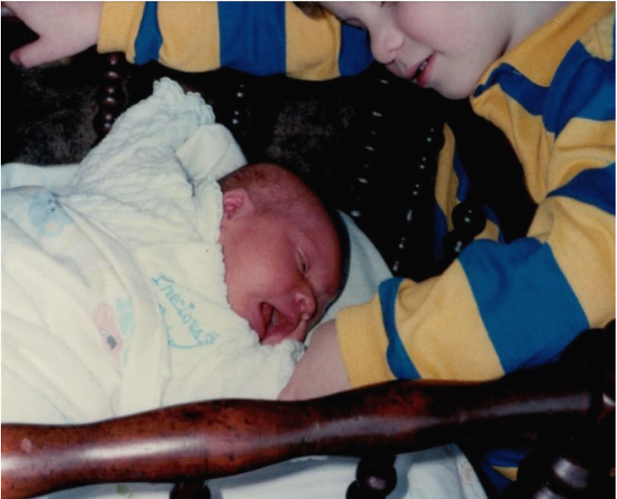
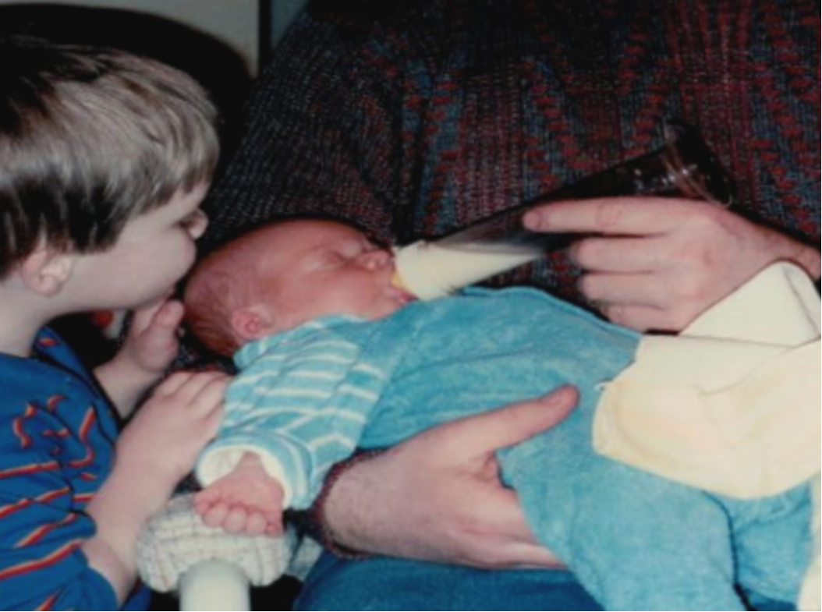

Slide 4
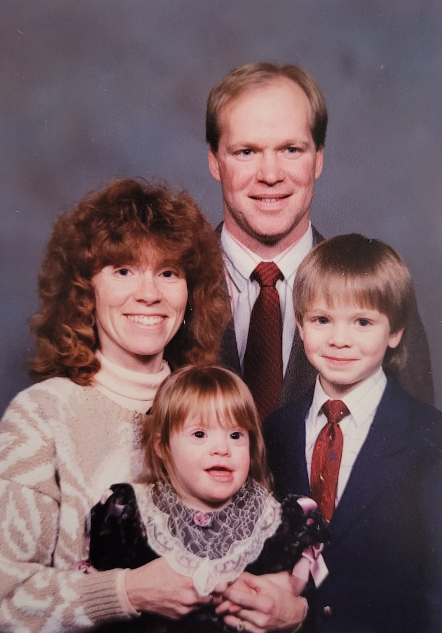
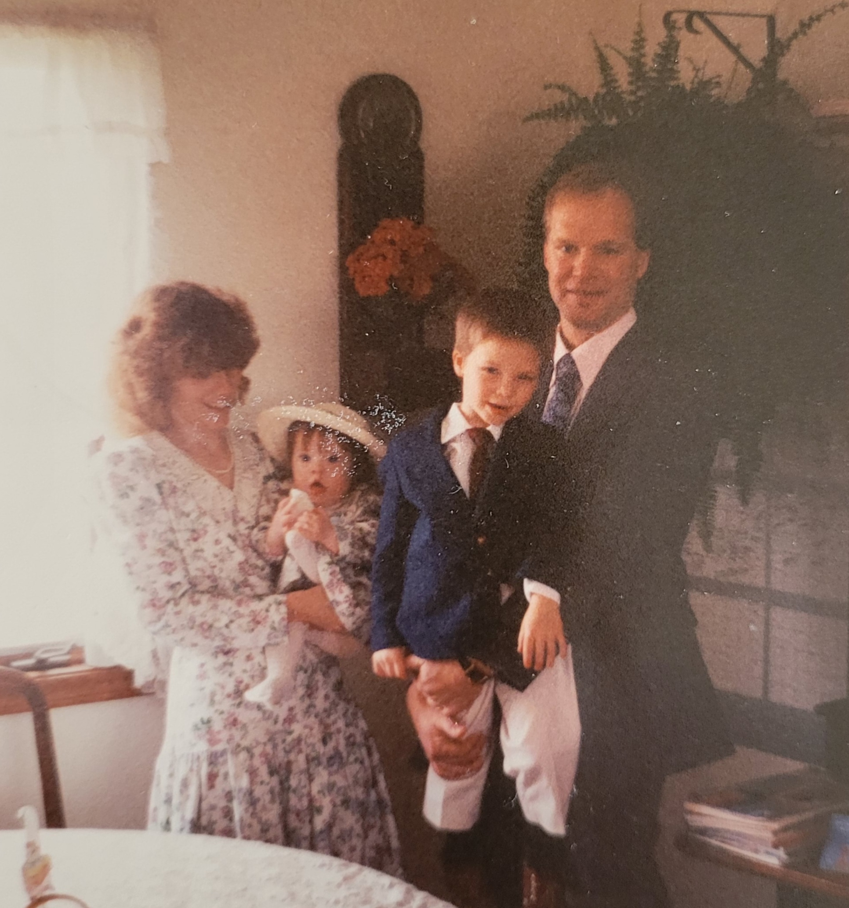

Slide 5
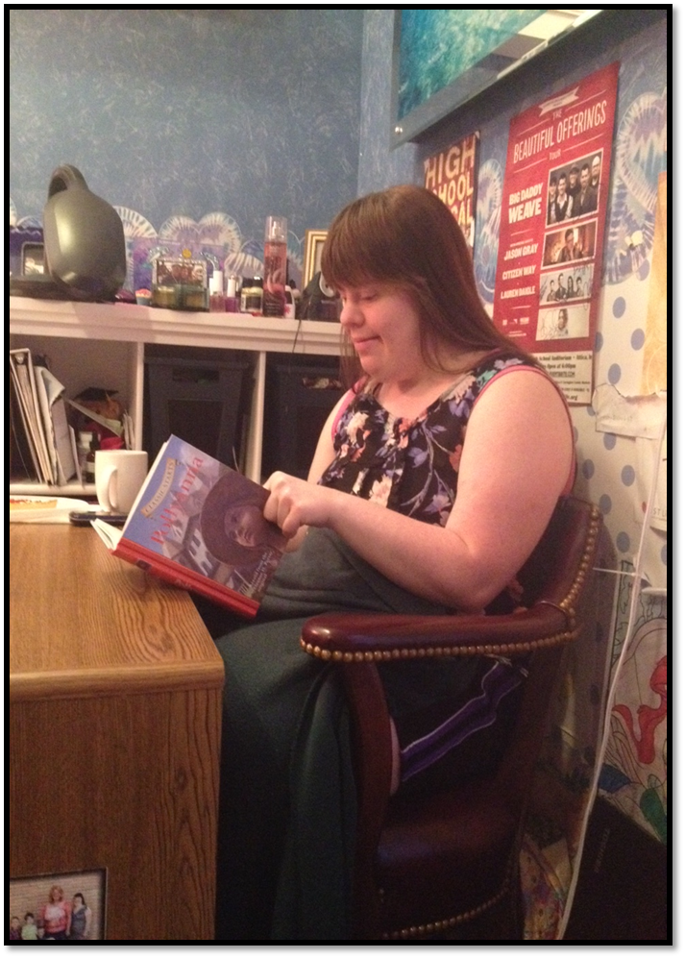
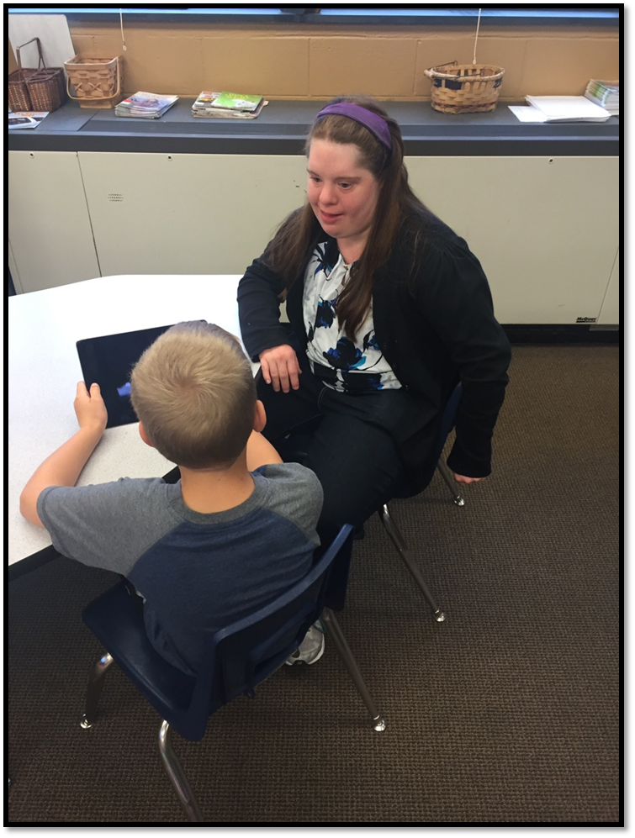

Slide 6
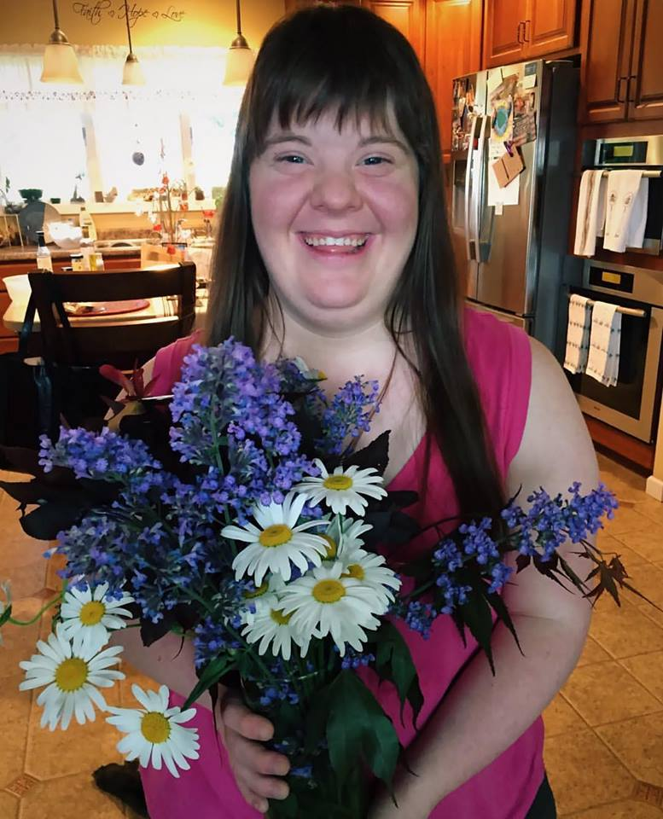
Everyone has the ability
to be impactful.
Isn’t that what you want to plan for?

Slide 7

The Problem with Traditional Special Needs Planning
Here’s the reality:
Traditional special needs planning is broken.
It focuses too much on what happens when parents are gone, but it doesn't address the real, day-to-day challenges families face today.

Slide 8

Traditional Planning Process
Shields money to prevent the disruption of government benefits
Allows your child to have more than $2,000 without losing access to government benefits

Slide 9

Traditional Planning Process
An effective way to protect against life’s unknowns
Allows you to efficiently move money from your estate into your child’s trust

Slide 10

Traditional Planning Process
Life Insurance
Special Needs Trust

Slide 11
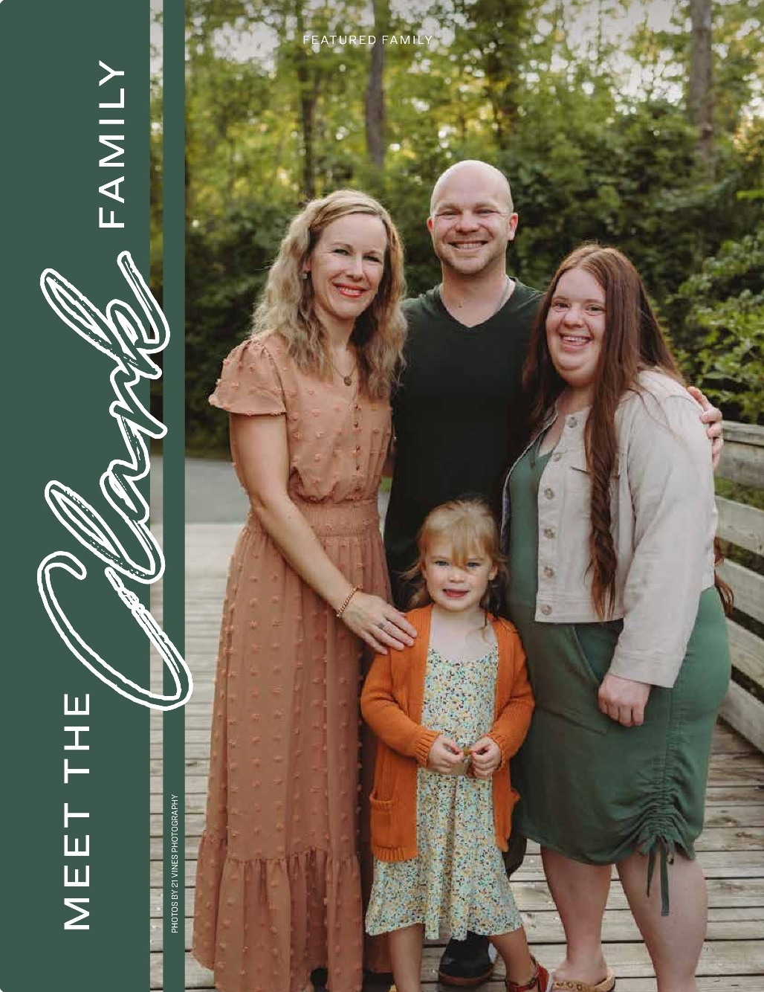
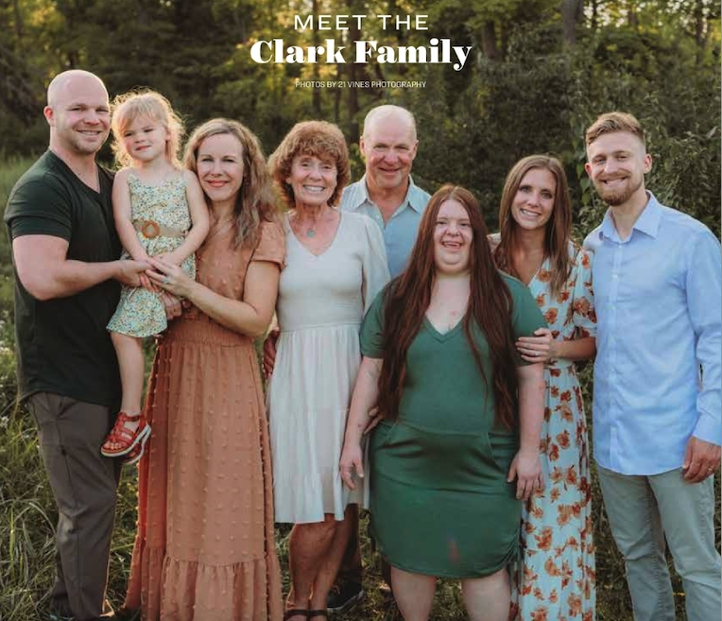
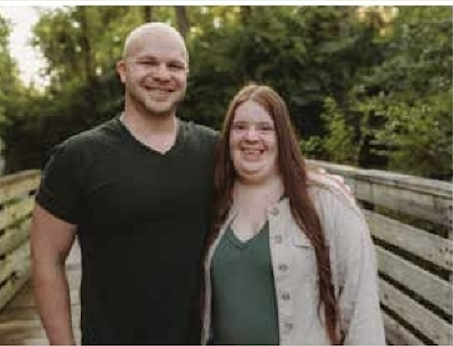
What do you want your life to look like?

Slide 12
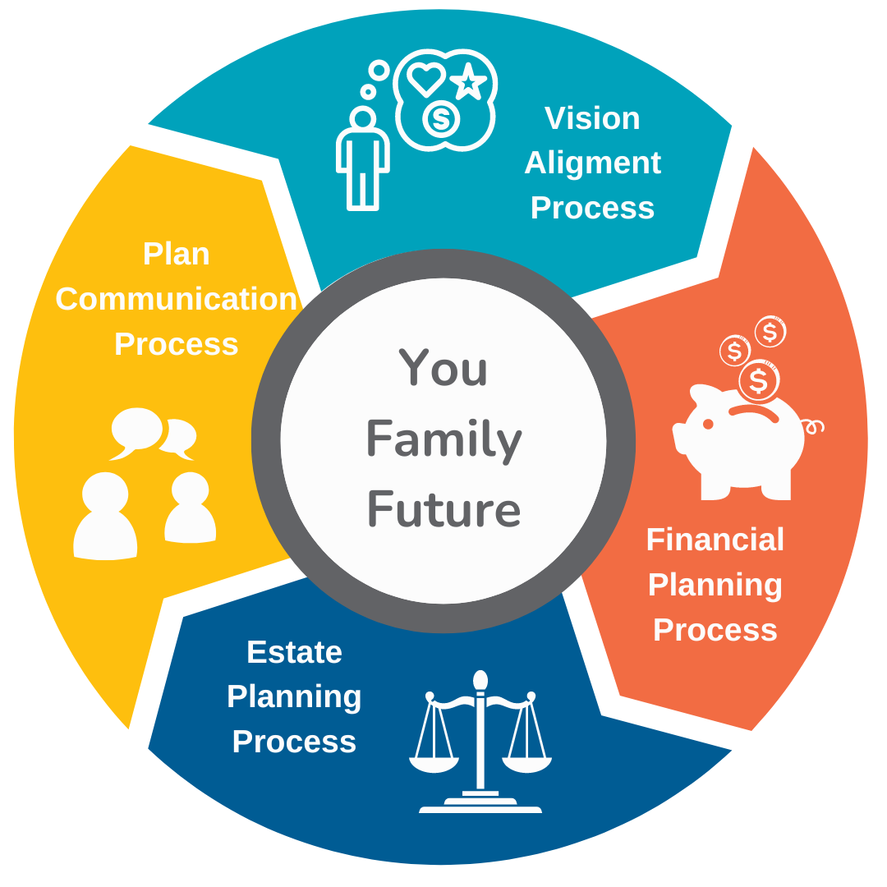
Special Needs Planning should help you get what you WANT from life, not just do what you need to do

Slide 13
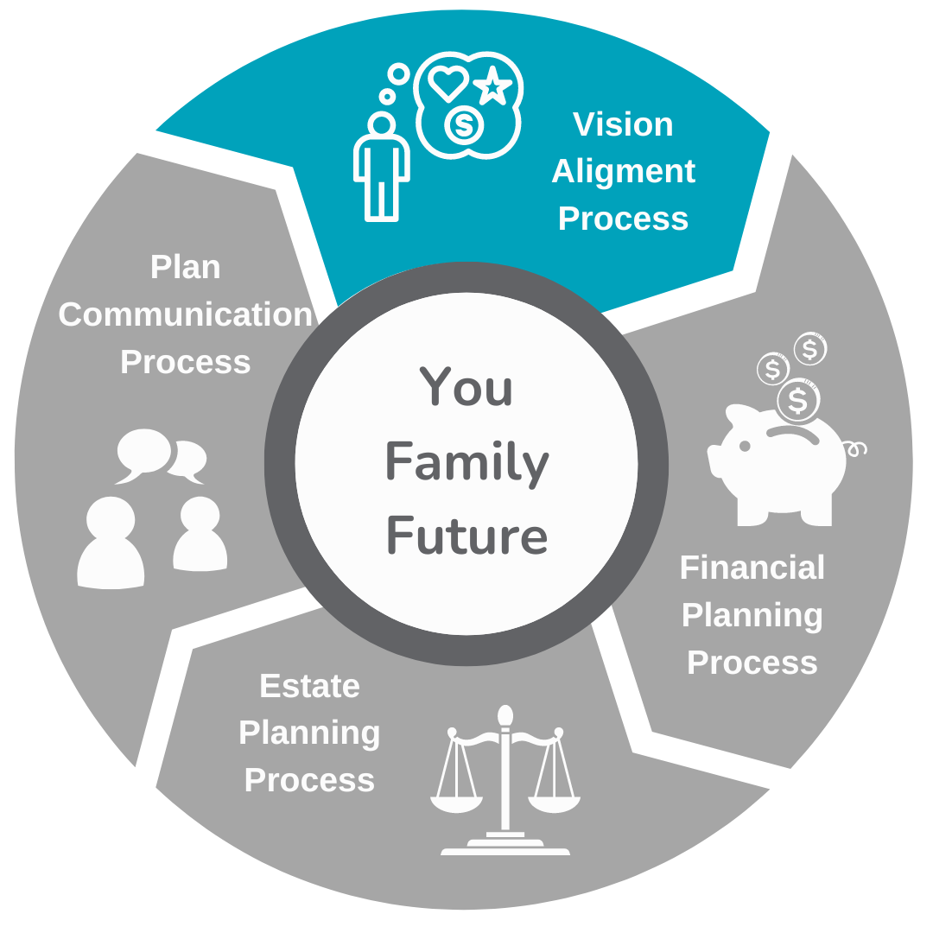
Vision Alignment Process

Slide 14


What does “Abundance” mean to you?

Slide 15


What does An Abundant Life look like for You?

Slide 16
What does An Abundant Life look like for You…
Over the next 6 months…
Over the next 3-5 years…
Over the next 10 years... and beyond

Slide 17

What does An Abundant Life look like for Your Child With Special needs?

Slide 18
What does An Abundant Life look like for Your Child With Special needs?
Over the next 6 months…
Over the next 3-5 years…
Over the next 10 years... and beyond

Slide 19
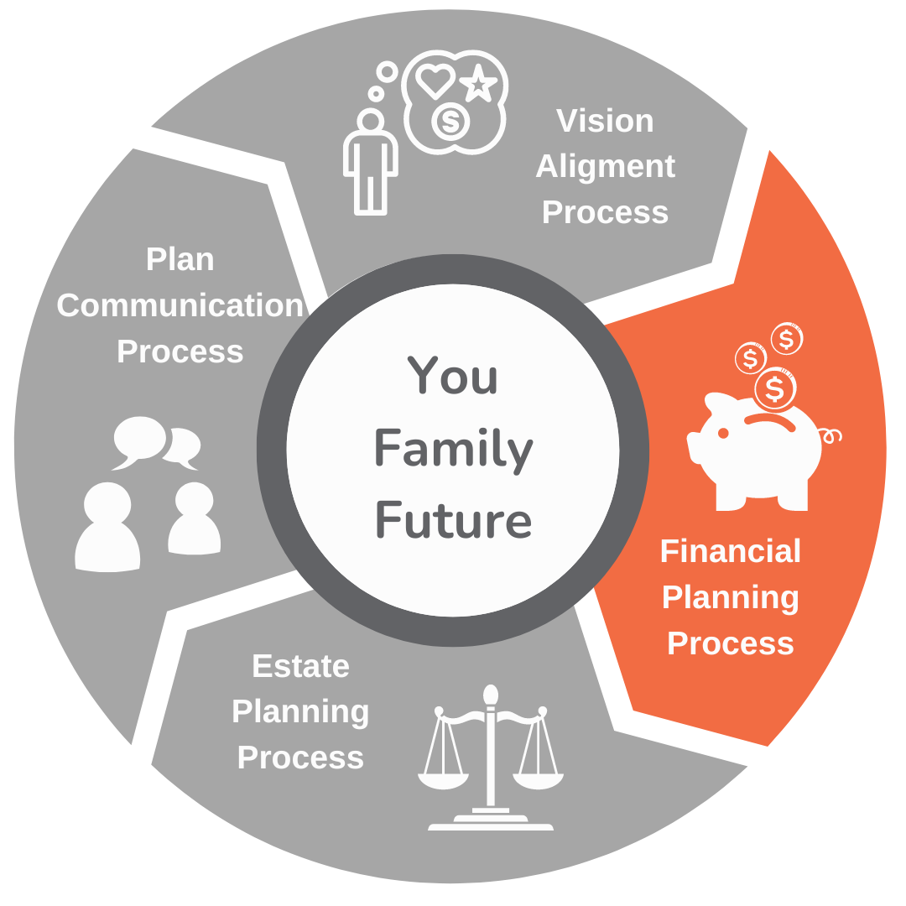
Financial Planning Process

Slide 20
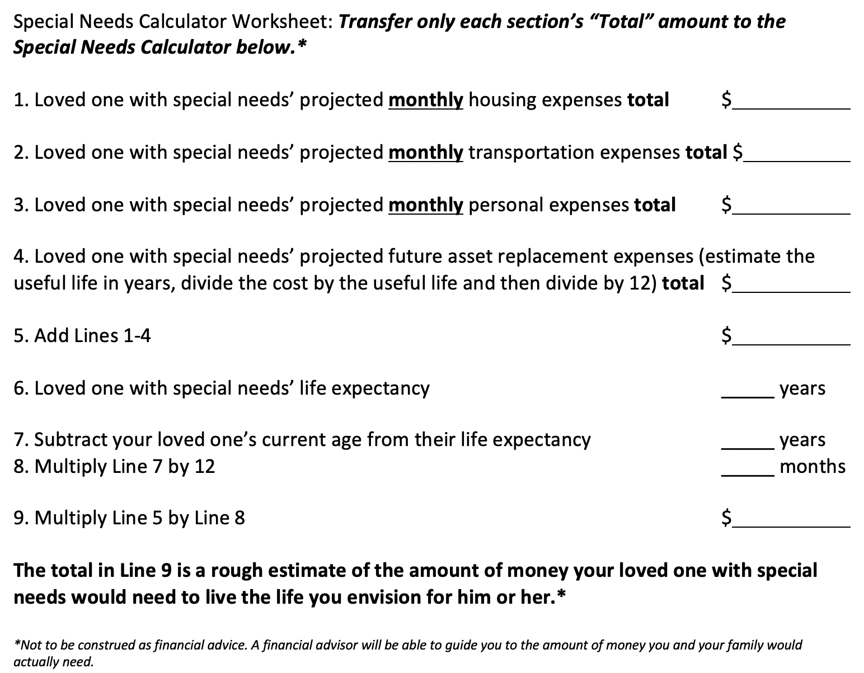
Special Needs
Financial Calculator
1,200
800
600
400
3,000
How much money does my
loved one need?
75
60
720
2,160,000

Slide 21

How to bridge the gap…
*For illustration only. Not to be construed as financial advice.

Slide 22
Savings Vehicles
Special Needs Trust
Achieving a Better Life Experience (ABLE) Account

Slide 23
Special Needs Trust
ABLE Account
1. Cost: Can cost $2,000-$5,000 or more to set up.
2. Impact on government benefits: Has no effect on means-tested benefits.
3. Type of savings strategy: Long-term estate planning strategy.
4. Remaining balances: A beneficiary may be named to receive remaining funds.
1. Cost: Relatively inexpensive to set up. For example, in Indiana, you can get started for as little as $25.
2. Impact on government benefits: Has no effect on means-tested benefits up to a limit of $100,000.
3. Type of savings strategy: Short- to mid-range planning strategy.
4. Remaining balances: Upon the death of the beneficiary, remaining funds may go to paying back Medicaid.

Slide 24
Family Financial Strategies
Emergency funds
College savings
Retirement savings
Retirement income strategies
Asset protection planning
Life insurance planning
Cash flow optimization
Tax efficiency strategies
Business planning
Estate planning

Slide 25
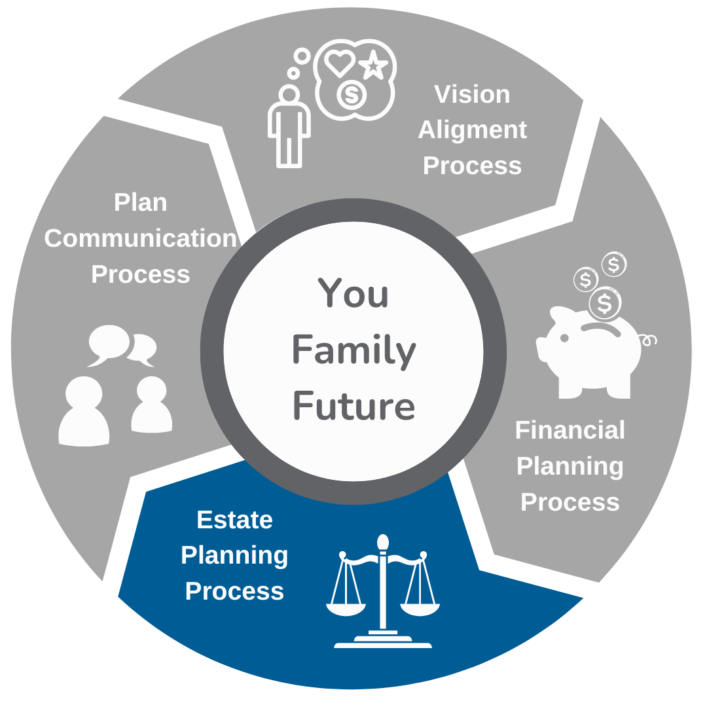
Estate Planning Process

Slide 26
Family Estate Planning Strategies
Wills
Living Will/Medical Directives
Trusts
Powers of Attorney
Special Needs Trusts (1st party)
Special Needs Trusts (3rd party)

Slide 27
Guardianship Options
Personal (family/friend)
Professional
State-appointed

Slide 28
Trustee
The person responsible for managing a special needs trust for a person with disabilities after the death of that person's parents or legal guardian. The trustee oversees assets, pays bills and taxes, and distributes trust assets according to trust documents with special attention not to disrupt government benefits

Slide 29
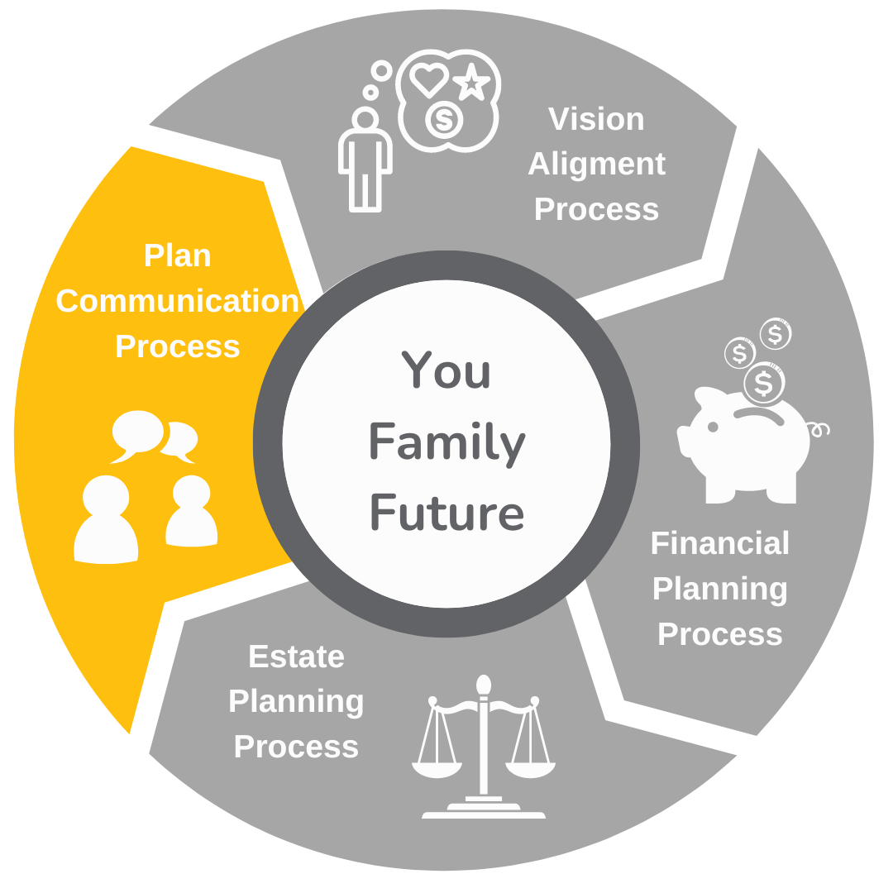
Plan Communication Process

Slide 30
Letter of Intent
Record, organize, and regularly update all the essential details about your child:
  Functional abilities
  Routines
  Doctors/Medications/Therapists/Therapies
  IEP details
  Key relationships
  Personal preferences (i.e., likes/dislikes)

Slide 31

Make it easy for someone to say “YES” to being your loved one’s future guardian

Slide 32



Future Support Team Meeting

Slide 33
Special Needs Planning should help you get what you WANT from life, not just do what you need to do

Slide 34


Slide 35
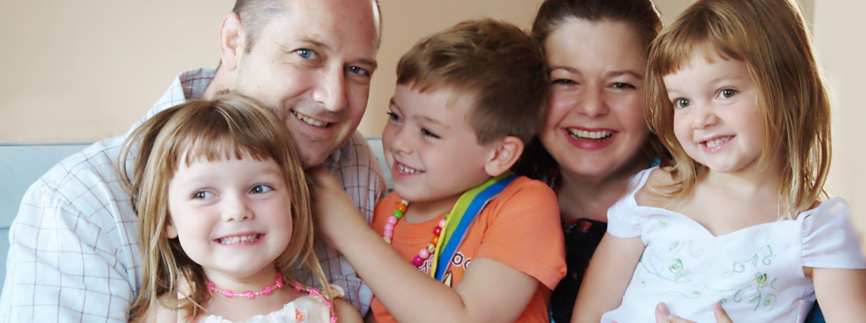
What does An Abundant Life look like for your entire family?

Slide 36
Book a Free MINI COACHING Session TO GET YOUR QUESTIONS ANSWERED: go.enablesnp.com/mini-coaching-session-free

Slide 37
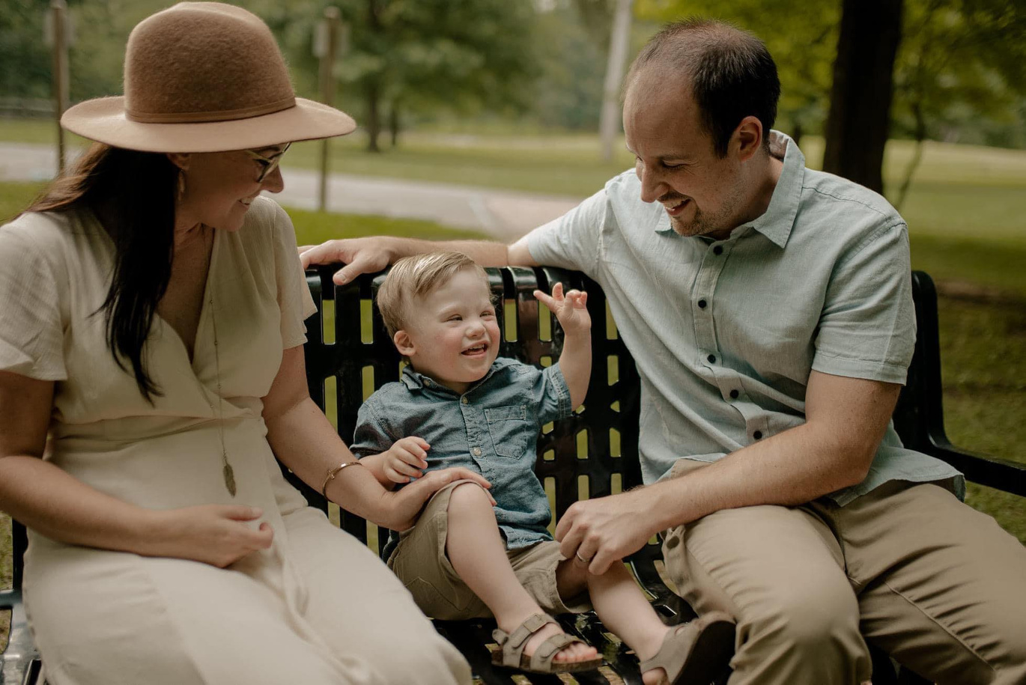
Let me introduce you to Lauren & Katlin from Virginia.
When they first found us, they felt hopeless trying to plan for their young son’s future.
All the moving pieces of the financial and estate planning processes felt overwhelming and confusing.
They didn’t know how to start securing their family’s future.

Slide 38
Let me introduce you to Lauren & Katlin from Virginia.
After connecting with our team, Lauren said she felt hope for the first time.
By developing a plan to prepare and protect their son, the heavy burden that Lauren had felt was lifted, and she finally had peace of mind knowing her son’s future was secure.

Slide 39
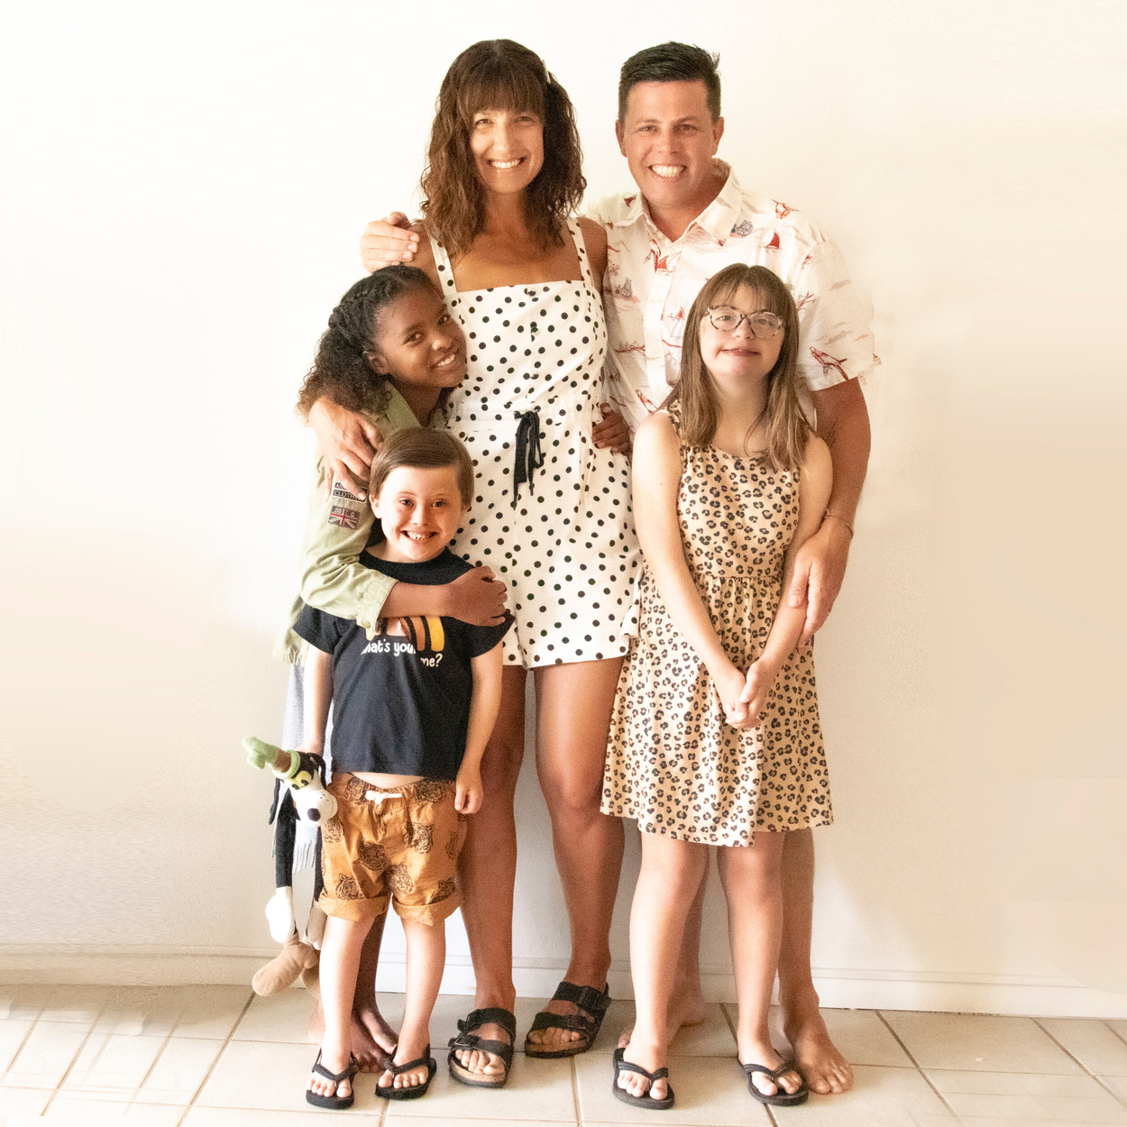
Let me introduce you to Josh & Heather from California.
You may recognize them as the founders of The Lucky Few podcast.
They adopted three children, two with Down syndrome, and were afraid of making mistakes, so they just kept putting off planning.
Josh didn’t feel like he had access to a knowledgeable team who really understood what his family needed.
Then they found us and everything changed for their family.

Slide 40
Let me introduce you to Josh & Heather from California.
By partnering with us, the Avis family’s lives were transformed...
As Josh put it:
'We can finally sleep at night because we have a team guiding us so we don’t make mistakes that will jeopardize our family’s future.’

Slide 41
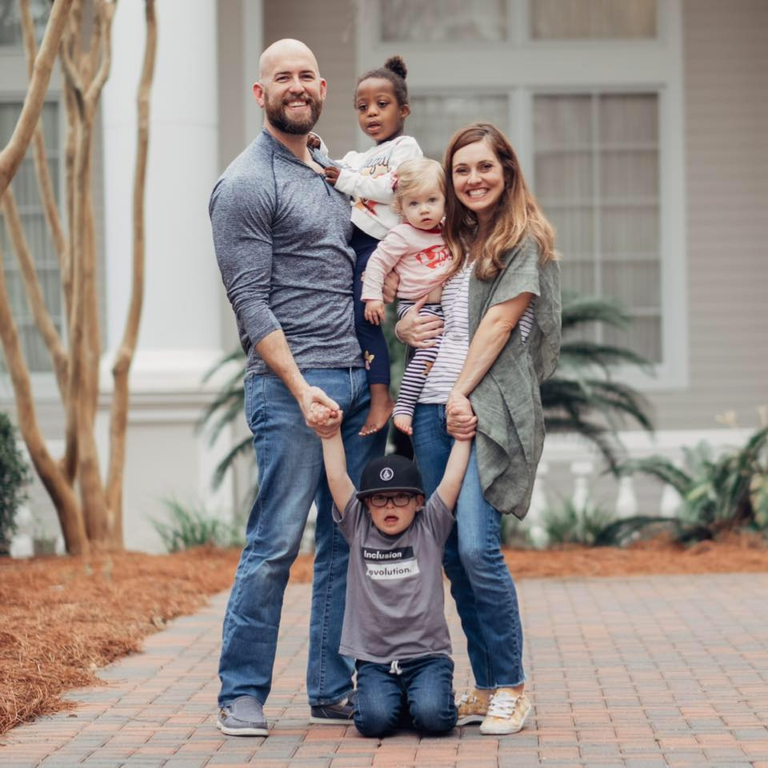
Let me introduce you to John & Carly from Texas.
They had also adopted two children with different abilities.
They started their planning journey by googling for answers but every search left them feeling more lost -- with no one to turn to for real guidance.
After working with us, they didn’t just create a plan—they found peace, clarity, and a renewed sense of direction.

Slide 42
Let me introduce you to John & Carly from Texas.
Now, John says:
'We have a relationship we can rely on to give us sound guidance in many aspects of our lives -- not just for our children and their future needs, but for our family business, and retirement goals, too.’

Slide 43
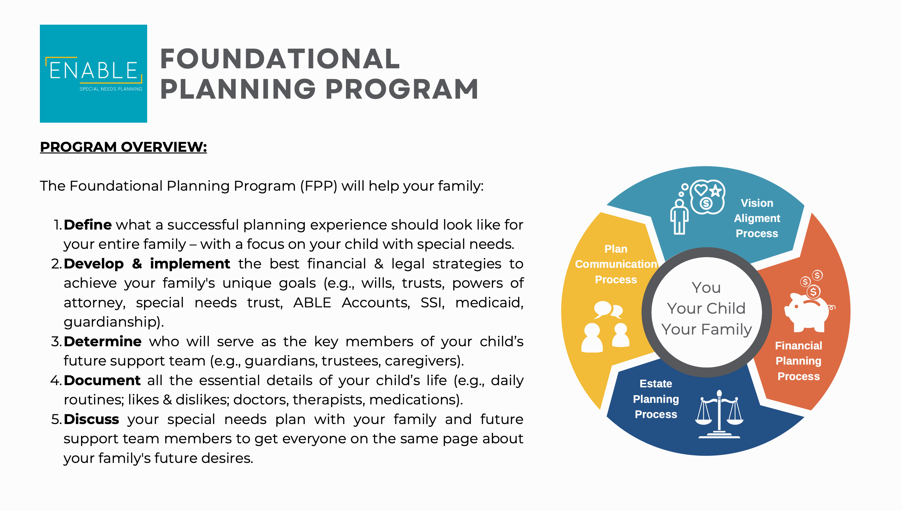

Slide 44
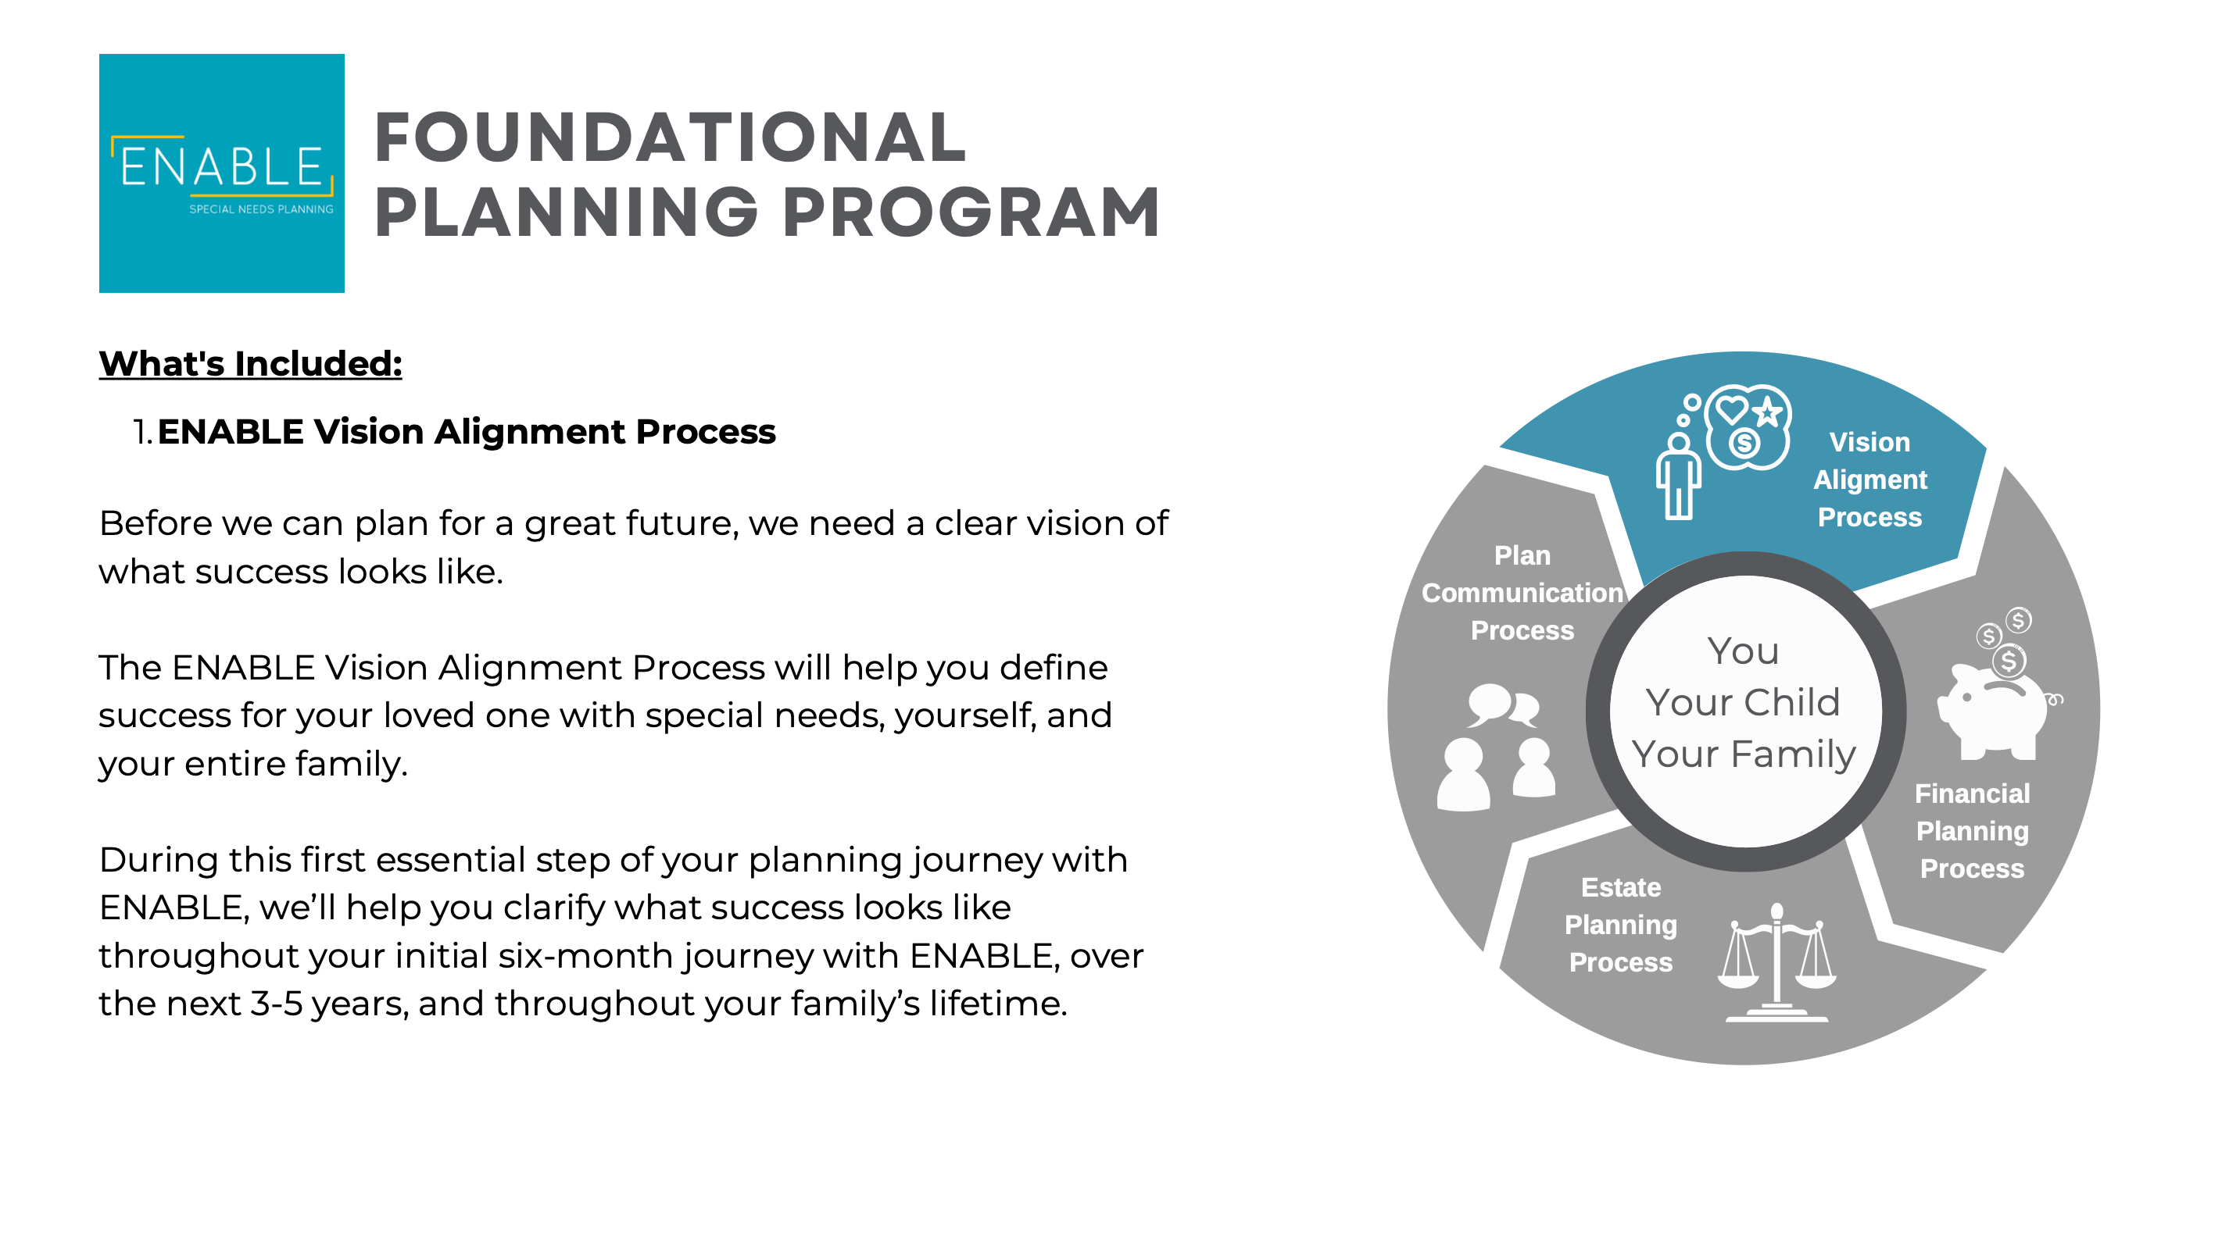

Slide 45
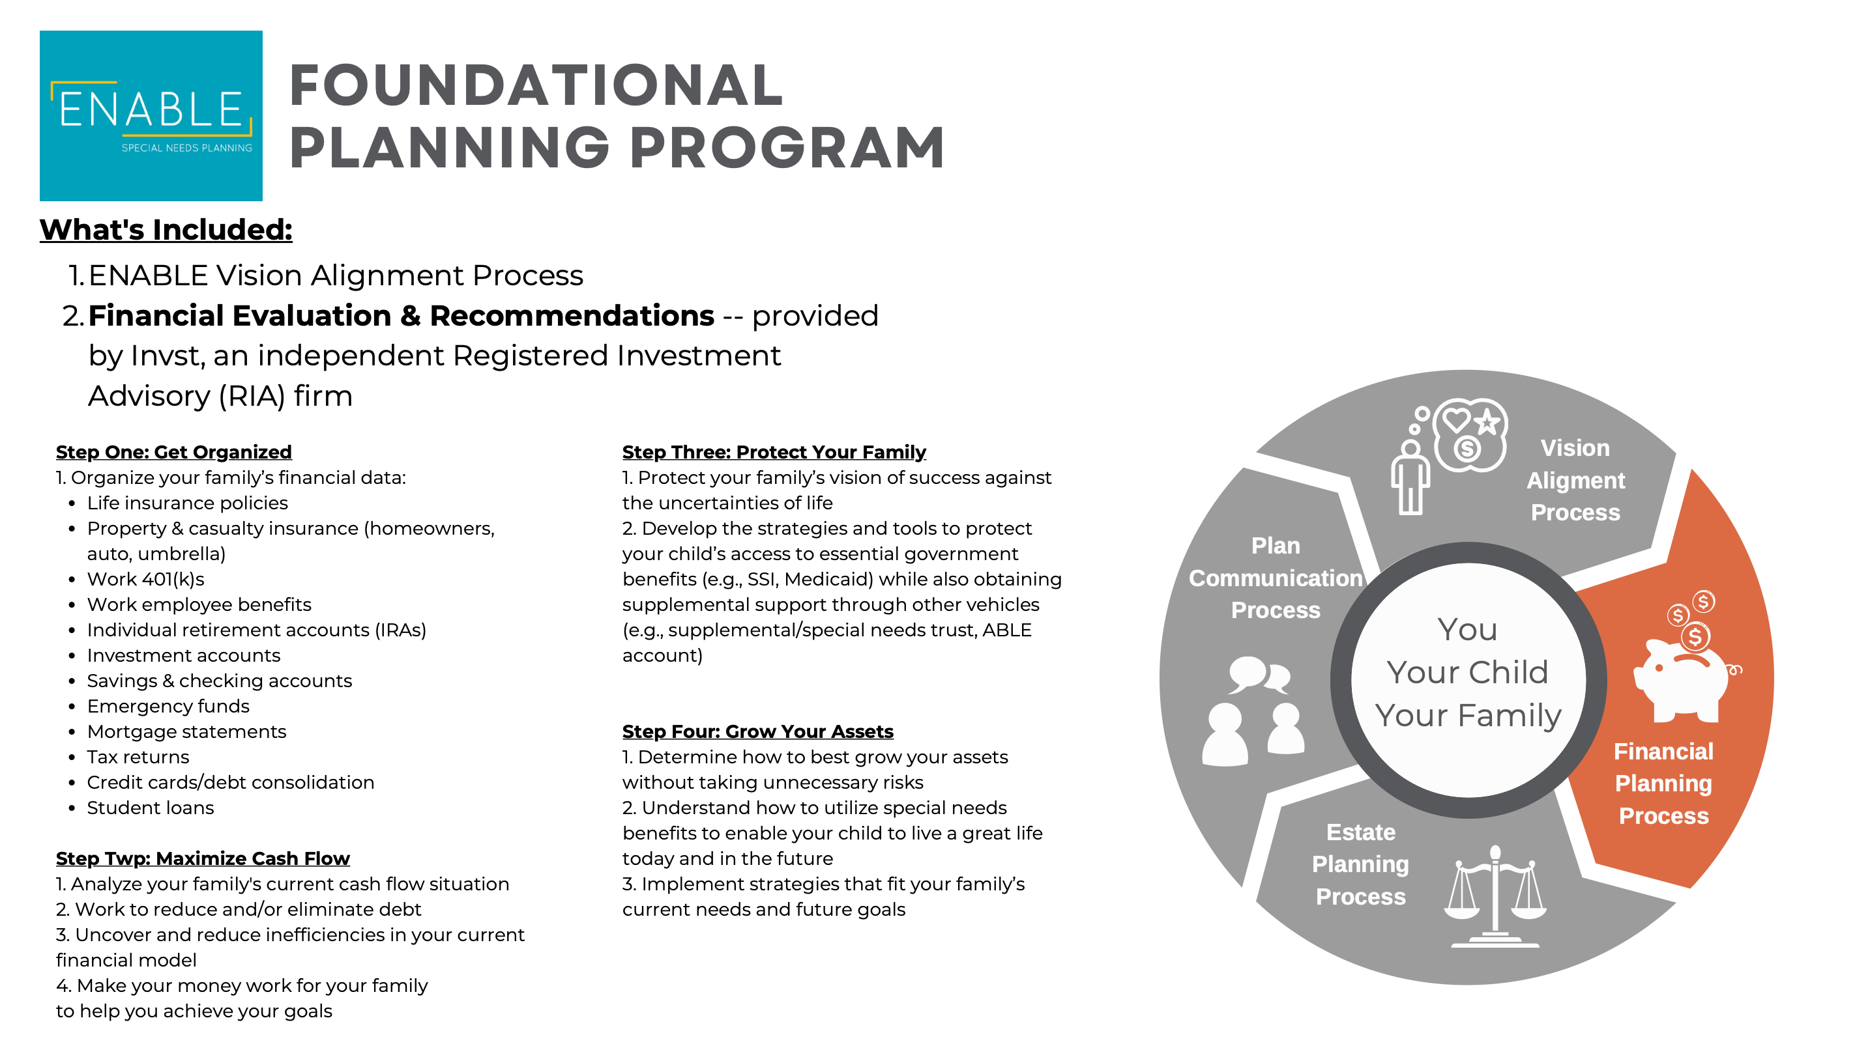

Slide 46
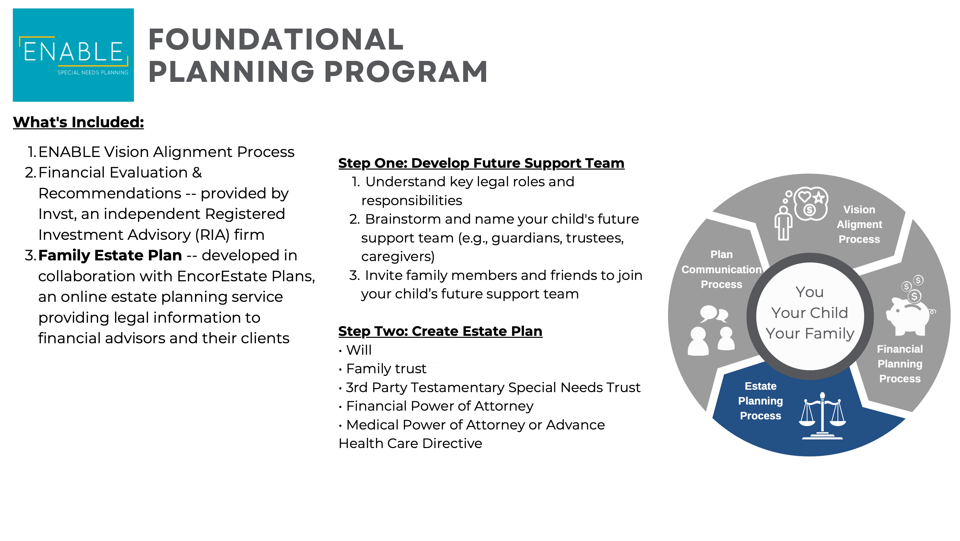

Slide 47
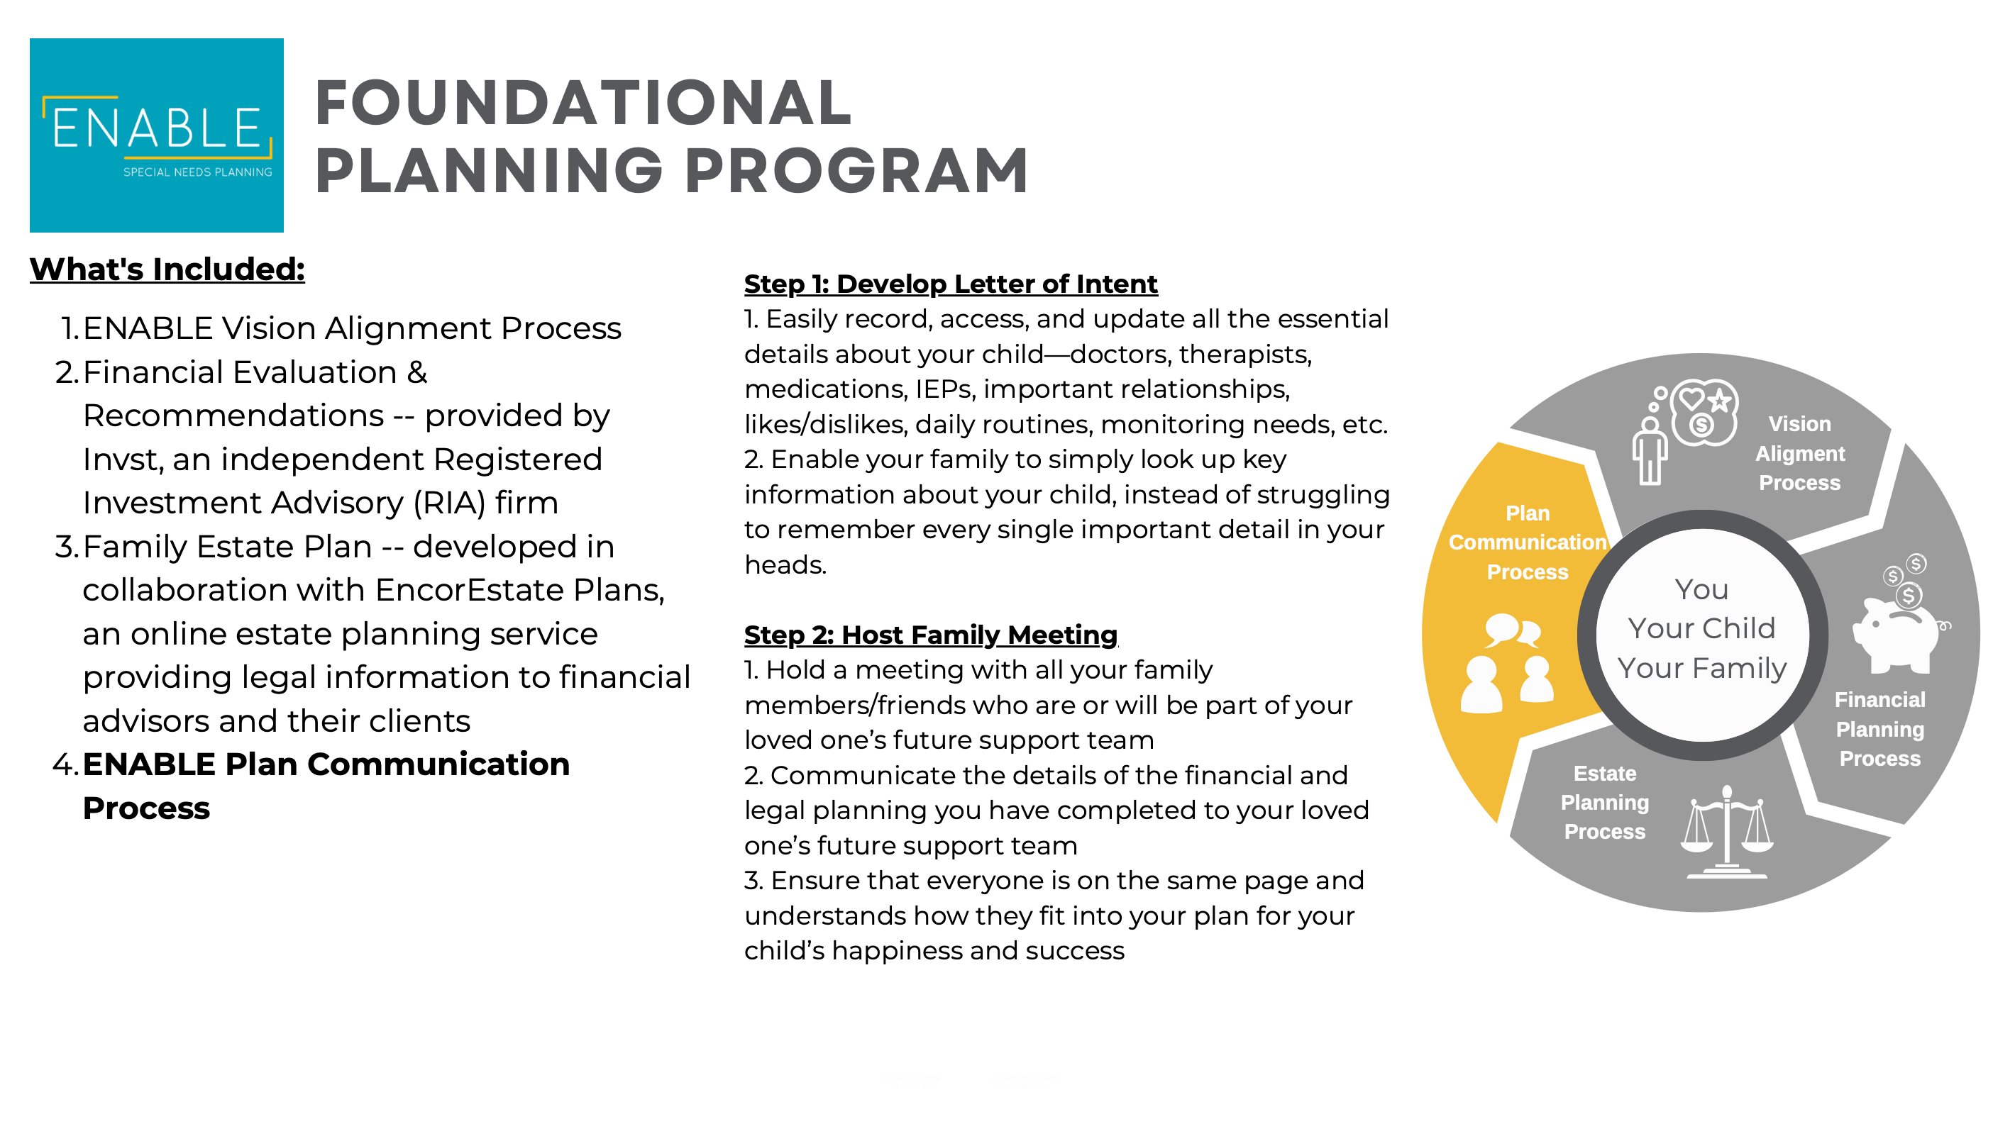

Slide 48
Q&A

Slide 49
Book a Free MINI COACHING Session TO GET YOUR QUESTIONS ANSWERED: go.enablesnp.com/mini-coaching-session-free

Slide 50
APPENDIX

Slide 51

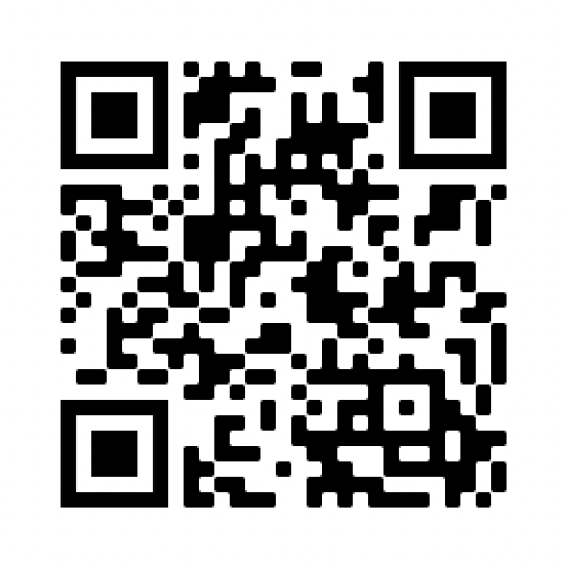
Join Our FREE Facebook™ Group for Families with Children with Special Needs Today!
Inside The Group, You'll...
Get access to live weekly interactive training sessions with Chartered Special Needs Consultants where you can get your planning-related questions answered in real-time...
Receive free special needs planning resources -- self-assessment tools, financial calculators, quick start guides, cheat sheets, and more...
Learn financial & legal strategies that you can easily implement to enhance your family's security and peace of mind today and for the future...
Connect with other amazing parents, siblings, caregivers, and service providers...
AND SO MUCH MORE!

Slide 52

What are your top 2 Special Needs Planning Questions you came to get answered tonight?
Write them down on the note card we’ve provided.
We will collect them soon.

Slide 53
Traditional Planning Process
Tells you what you need to do.

Slide 54
Financial Planning

Slide 55
Legal/Estate Planning

Slide 56
Communicating Your Plan

